Slide 1

Kaltura
Player Platform 2.0
August 2013

Slide 2
Key Advantages of Player Platform
High performance full featured lead with HTML5
  Most players display in 1 second or less.
Configure skins once with standard HTML / CSS
Better support for additional platforms; iOS and Android player components.
Supports all features across multiple platforms: player.kaltura.com

Slide 3
Technical Overview
Feature | Description
Updated Design | Unified flat design Easier to customize
Refactored Components | Improved configuration mechanism, skin components are more plugin based. Cleaner separation of uiEvents from core embedPlayer Unified JSON based config ( no more kaltura uiConf xml ) HTML5 first, flash fallback is chromless ( write plugins once for html5 )
Standard Features | Info tab Share tab Playhead frame seek preview Related Videos Flavor Selector, Adaptive Streaming Unified 508 compliant player ( no separate 508 player any more )
Cross Platform: HTML5, Native and Flash | Single player framework wraps, flash, native iOS, native Andorid, and of course HTML5. Enables you to deliver features like DRM, offline viewing, adaptive streaming, via native or plugin components, while still leveraging single unified configuration and the same player platform cross devices. Minimizes costs in cross platform feature delivery.

Slide 4
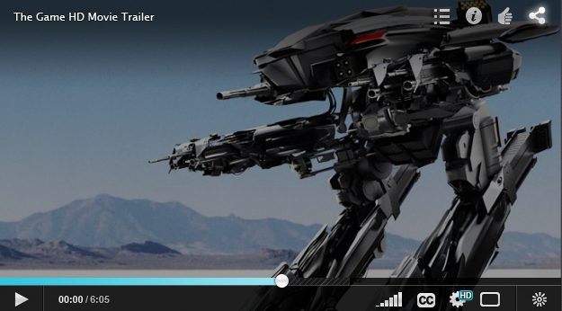
Basic Look and Feel of Updated Player
Note: The end player result maybe slightly different from presented mockups

Slide 5
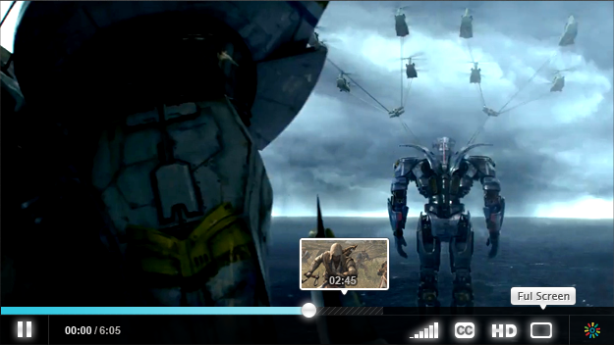
Mouse Over Scrubber
Thumbnails for time displayed on mouse over, and touch playhead scrubbing.

Slide 6
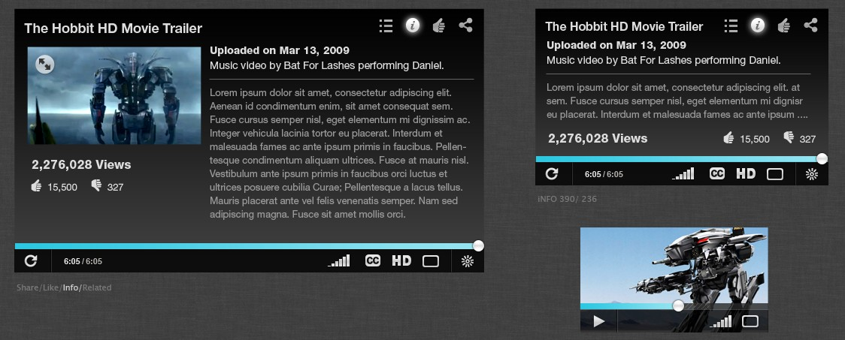
Responsive Player Layout
No more star ratings just + or -
Smaller players / screens keep important components.

Slide 7
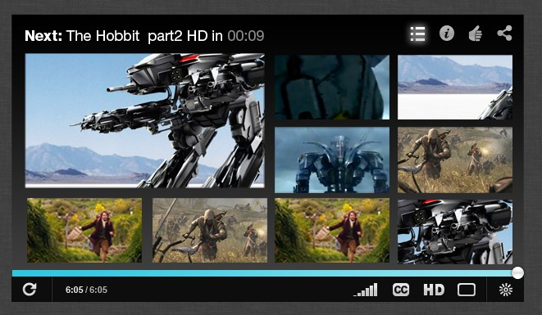
Related Videos
Enhanced related videos interface
Flexible options for related video fulfillment
Events for tracking conversion / retainment

Slide 8
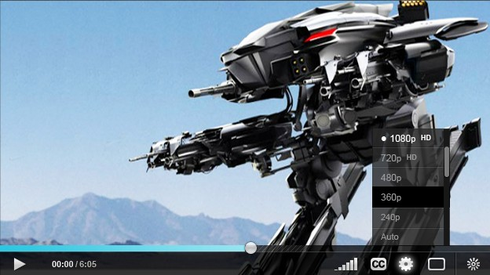
Adaptive Streaming Flavor Selector
Chromless Flash HLS
  Supports HLS on desktop browsers + iOS.
MPEG-DASH for MediaSource API browsers
Unified interface and events for source selection
Multi language, track selection ( Dash + HLS )

Slide 9
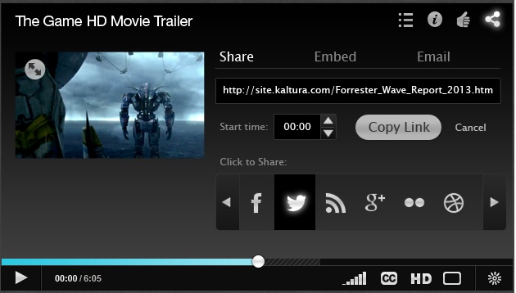
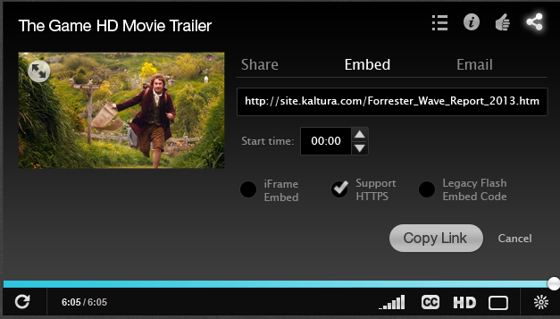
Share In Player and Out
Robust Configurable Share Options
  Start time, iframe, flash object, hosting page url
Inside and outside player share

Slide 10
Accessibility, 508, WebVTT etc
New player has and stricter 508 compliance
  tab indexes focus, screen reader testing etc.
Updated UI for caption selection
  Supports caption toggle for single caption stream entries

Slide 11
iOS, Android, HTML, Flash all in 1.
Native player component with JavaScript bindings
On Page Javascirpt Plugins
iOS Native
KDP API
Android Native KDP API
Browser Embed JS KDP API
Unified JSON Configuration, per player ID
CSS Based Skin
Plugins with UI
Plugins
JavaScript HTML5 Api
Android MediaPlayer
iOS Media Player Framework
Browser HTML5 API
Browser Chromless Flash
DRM
HLS
Offline
DRM
Offline
MPEG DASH
EME
OSMF HLS

Slide 12
Timeline
Kaltura updated player available in limited availability early September
Updated player studio end of 2013
Lead with HTML5 for new players start of 2014

Slide 13


